Slide 1

Angular - AOT Compilation
Pandiyan Murugan

Slide 2
What is AOT?
In computer science, ahead-of-time (AOT) compilation is the act of compiling a higher-level programming language, or an intermediate representation code, into a native (system-dependent) machine code so that the resulting binary file can execute natively.

Slide 3
Compilation in Angular?
Why we need compilation in angular?
Our angular application view will have various components and bindings in it. All of those things needs to run natively in JavaScript in the browser. So it needs to compiled down to native JavaScript.
In angular?
In angular, TypeScript is transpiled into Javascript.
For example, we have concept called component, decorator, etc. Browser cant understand the components, so its should compile into browser understandable code.

Slide 4
The virtual machine friendly code
The compilation can be done in:
1
Just In Time (JIT) – Compilation happens in Run Time.
2
Ahead Of Time (AOT) – Compilation happens in Build Time.

Slide 5


Just In Time Compilation
Happens at Run time
1
2
3
tsc compiler at the build time TypeScript -> JavaScript
ngc compiler at run time Angular JavaScript code -> Native JS
Compiler runs every time

Slide 6

Ahead of Time Compilation
Happens at build time
1
2
3
ngc compiler at build time
compiler runs only once
Built into angular CLI build process

Slide 7
Tree Shaking & Minification
Removes the unused codes & minifies the files
1
like leaving unused leaves in the trees Tree Shaking
2
Minification in JIT wont minify the HTML
3
But in AOT, everything gets compiled into inline in one file. So when minification happens properties get minified and renamed in both scripts and HTML

Slide 8
Build Commands
The compilation can be done in:
1
Just In Time (JIT)
ng build
ng serve
2
Ahead Of Time (AOT)
ng build --aot
ng serve --aot

Slide 9
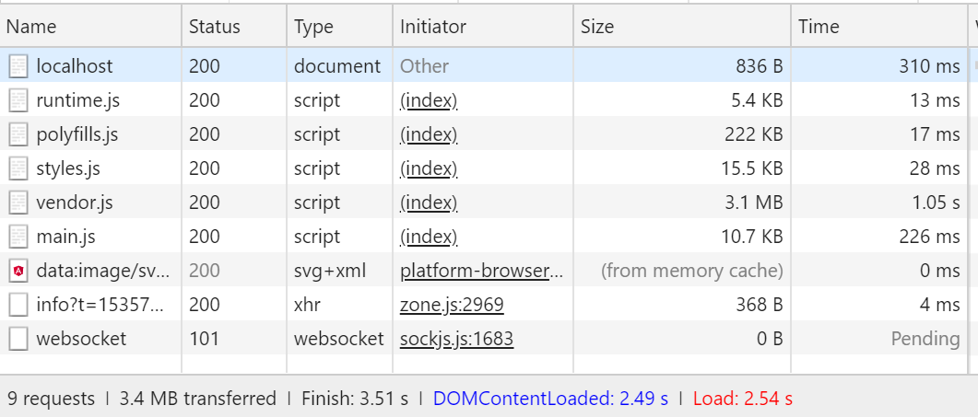
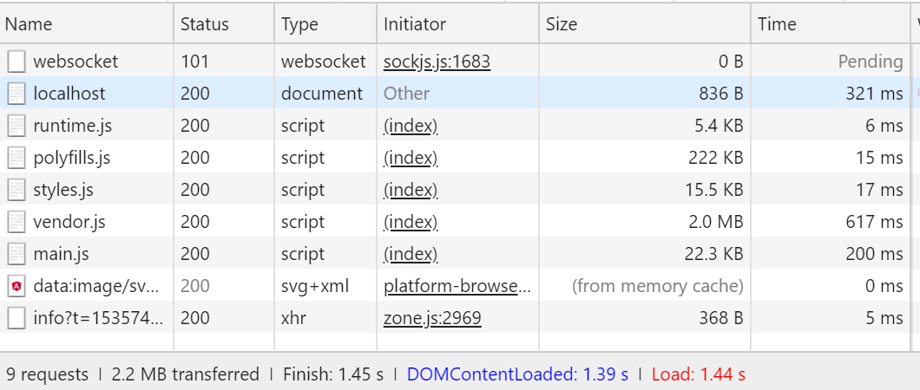
Load Time Comparison
JIT ng serve
AOT ng serve --aot

Slide 10


What’s Next?
Click the Subscribe button
Follow us
And show us your continuous support.
https://efficientuser.com
https://twitter.com/efficientuser

